Slide 1

Keyword Analysis 2
Brought to you by the Gould Library Data Services

Slide 2
Keyword Analysis 2 – Word2Vec
In the previous slides, we learned the basic concepts of keyword analysis and associated keyword analysis
This PowerPoint slide will introduce the concepts of Word2Vec and how to use Word2Vec to extract associated keywords

Slide 3
What is word2vec?
One-hot encoding
In order to express a particular word, we create a n value vector and place the number 1 on the particular word and 0 on other words. For instance, if we had a data of [potato, strawberry, apple, watermelon], the vector will show this as [0, 0, 1, 0]. In other words, we are creating a DTM
Word Embeddings as a Vector
Word embeddings as a vector assumes that similarly distributed words have similar meanings. (The original one-hot encoding method has a shortcoming of difficulty understanding the difference between two or more words and this word embeddings as a vector solved this shortcoming. Because we vectorized the meaning of a word, questions like Carleton:StevieP=Library:X the computer can answer X as Gould Library or other libraries.
Word2Vect
Word2vec was first announced by Google in 2013 by improving the original Word Embedding method. Hence, based on the given word, the Word2Vect infer whether or not a particular word would appear or not. Thus, the closer the word is, the more it will be associated with the given word.

Slide 4
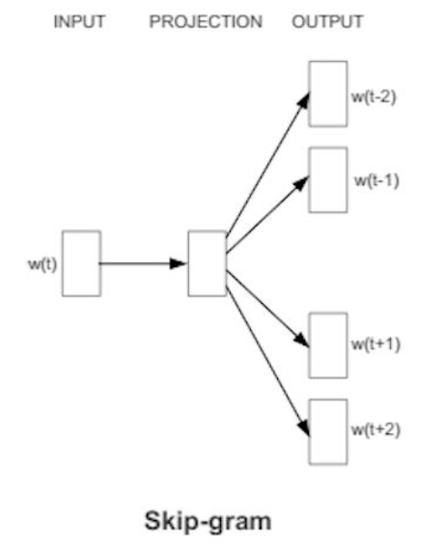
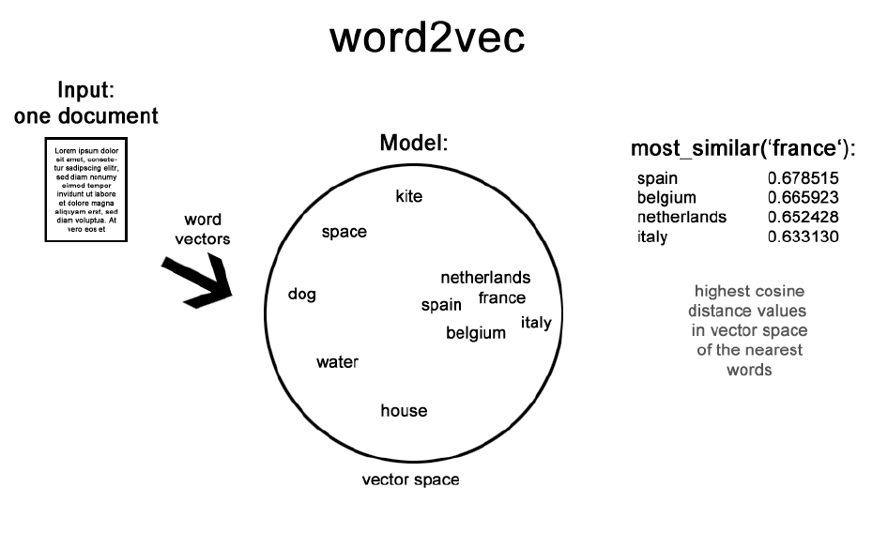
What is word2vec?
Word2vec is created through neutral network learning.

Slide 5
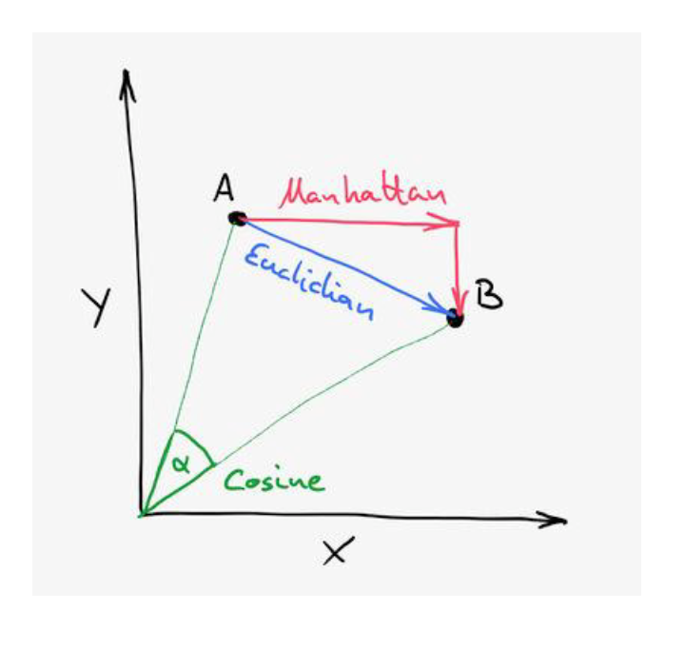
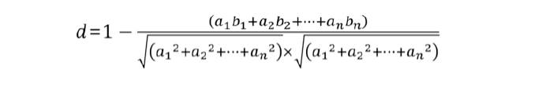
How the distance is calculated
Euclidean Distance
The shortest distance that connects the two points, which is found by the Pythagoras theorem
Manhattan Distance
The word came from the Manhattan’s checked pattern roads and was designed to find the fastest route
Cosine Distance

Slide 6
